Slide 1
Face detection and recognition
In a group image
Group Number:23
1.Bhagyashree 1pe13ec024
2.Chethan Kumar TJ 1pe13ec031
3.Mridula C 1pe13ec076
Guide: Dr. Subhash kulkarni
27/09/16

Slide 2
OBJECTIVE / PROBLEM STATEMENT
For a given group photo detect and isolate individual faces and subject it to recognition
27/09/16

Slide 3
ABSTRACT
Face recognition has been one of the most important and interesting research fields in the need of automatic recognition and surveillance systems. In this report we go through general ideas of detection and recognition in a group image. A near real time detection system is to be developed that uses skin-tone colour model for face detection and facial point detection method for face recognition
27/09/16

Slide 4
PREREQUISITES
Subject Knowledge: programming skills,Image processing,Linear Algebra
HARDWARE : image capturing device (eg-Camera,Mobile)
SOFTWARE : Matlab(Image processing toolbox),OpenCV,Python
27/09/16

Slide 5




DESIGN FLOW WITH TIMELINE
Data base building
3/10/16
Literature collection
Pre processing
15/10/16
Face detection
15/12/16
Feature set
Building and
Recognition
15/2/17
Demonstration
And compilation
15/4/17
Android enabled
App building
1/4/17
Integration
and Testing
15/3/17
App development and Open CV will be learnt parallely along with face detection and recognition
27/09/16

Slide 6
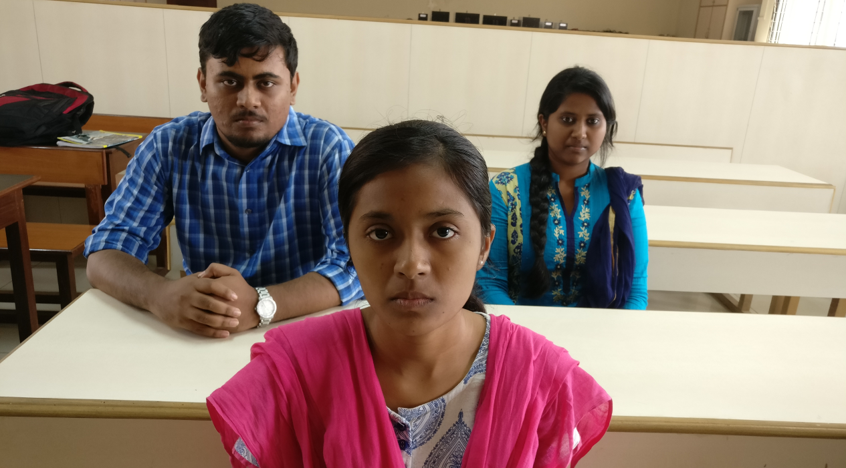
EXPECTED RESULTS
To identify each person in a group photograph through facial features through an android app.
27/09/16

Slide 7
REFERENCES
Face recognition in a group photograph – Simranpreet kaur
ISSN:2319-7064
Face recognition from group photograph-Kavita Shelke
ISSN:2277-3754
IEEE papers
27/09/16

Slide 8
THE END
27/9/16

